Slide 1
Anomaly Detection For Time Series
using VAE-LTSM Hybrid Model

Slide 2
Content
Introduction
VAE-LTSM
Dataset
Results
Next work

Slide 3
Introduction
Anomaly Detection for time series
- The training data are often unbalanced with very few labelled anomalies -> Unsupervised learning models.
- Context anomalies depend on the value of surrounding data points and thus local information is required for their detection
- Collective anomalies always occur in sequence over a reasonably long period -> RNNs (LSTM).

Slide 4
Background and related work
VAE module: Forming robust local features over a short window
LSTM module: Estimating the long term correlations in the sequence
Hybrid: Means processes a sequence of data points over a short period of time to form a local temporal basis for the latter sequential module to build upon.
-> Using VAEs as local feature extractor and coupling it with a LSTM module to take care of long-term trends.
-> Module is applied to embeddings that represent a local window, which make algorithm capable of ignoring redundant raw samples and tracking events over longer terms.

Slide 5
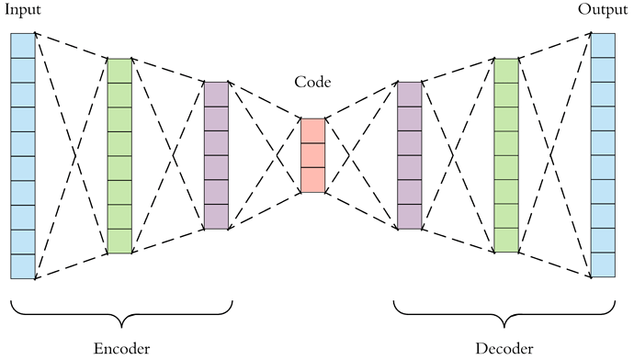
Autoencoder
Encoder: take input as a n-dimensional vector, output is a m-dimensional vector (m<n)
→ Dimensionality Reduction
Decoder: reconstruct the n-dimensional vector

Slide 6
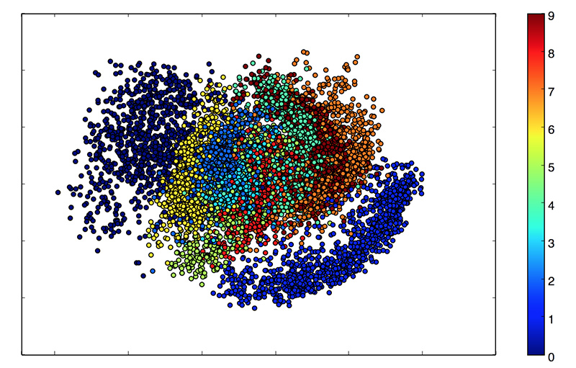
Variational Autoencoder (VAE)
Problems with Autoencoder:
The fundamental problem with autoencoders, for generation, is that the latent space they convert their inputs to and where their encoded vectors lie, may not be continuous, or allow easy interpolation.
Decoder will generate an unrealistic output because it can’t deal with blank region.

Slide 7
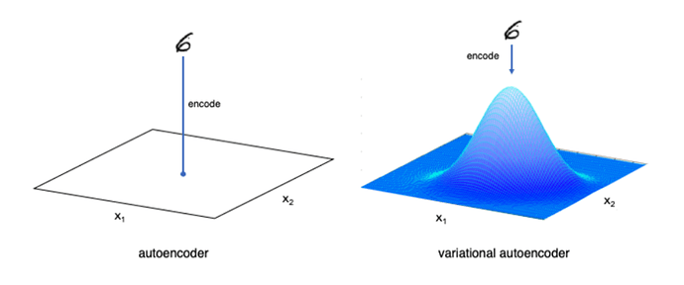
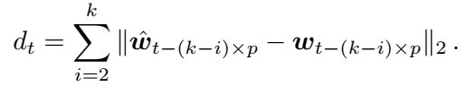
Variational Autoencoder (VAE)
VAE: represent data with a probability distribution
Continuous space
→ Capable of generating new sample
Score function:

Slide 8

Long short-term memory (LSTM)
LSTM is a development form of Recurrent Neural Network
→ Suitable with time series data

Slide 9
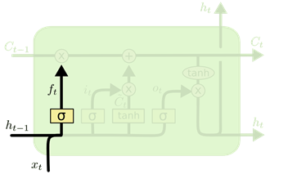
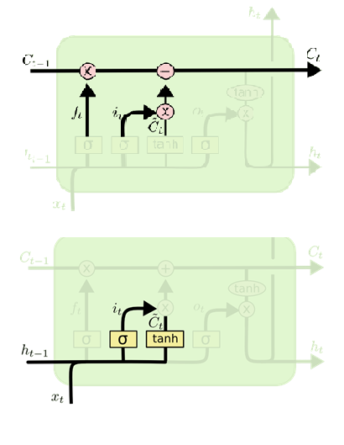
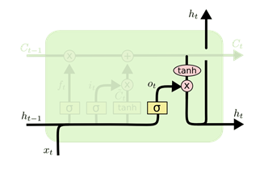
LSTM’s architecture
2. Input gate: discover which value from input should be used to modify the memory
1. Forget gate: remove unnecessary information form cell
3. Output gate: the input and the memory of the block is used to decide the output

Slide 10
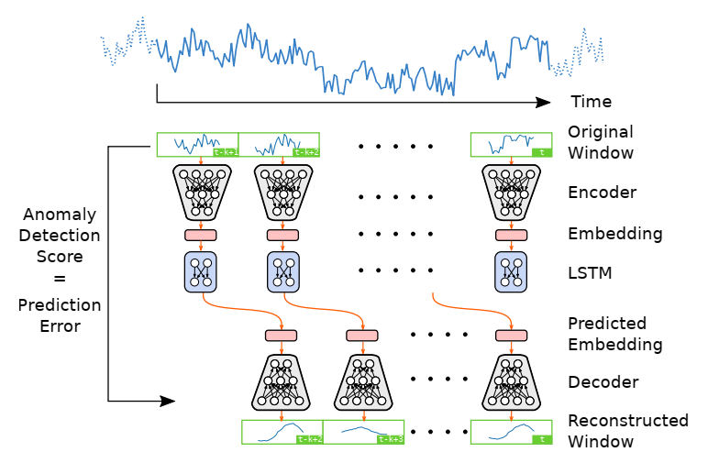
Hybrid model
Anomaly detection algorithms based only on VAEs often fail in detecting long-term anomalies, as VAE models cannot analyze information beyond a short local window
→ VAE-LSTM

Slide 11
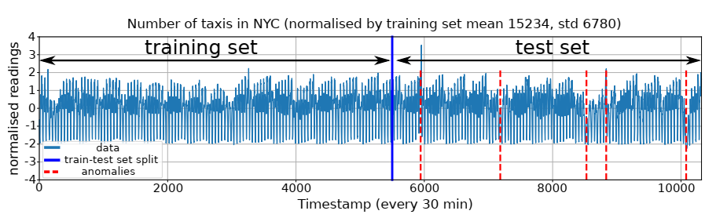
Training
Training and testing set seperated from a single time series. Training set has no anomalies
10% of training set is reserved for the validation set, which is excluded from training

Slide 12
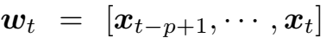
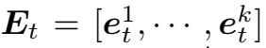
Training
Train VAE using rolling window of size p on training data
Train LSTM on embeddings of a sequence of k non-overlapping windows
Data
x1 | x2 | x3 | x4 | x5 | x6 | x7 | x8 | x9 | x10 | x11 | x12
w1 |  |  | w2 |  |  | w3 |  |  | w4
e1 |  |  | e2 |  |  | e3 |  |  | e4
W1 |  |  |  |  |  | W2
E1 |  |  |  |  |  | E2
Window
Embedding
Sequence
Embedding sequence

Slide 13
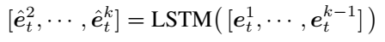
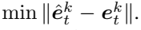
Training
Optimize VAE model to maximize ELBO loss
Use trained VAE encoder to estimate all embedding sequence E_{t} in the training set.
Have the LSTM model take the first k-1 embeddings in E_{t} and predict the next k-1 embeddings:
Optimize LSTM model by minimizing the prediction error of final embedding:

Slide 14
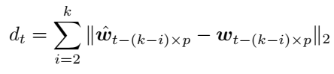
Testing
Use VAE encoder to estimate embedding sequence E_{t} from test sequence W_{t} , which contains k*p past readings from t
Feeds the first k-1 embeddings to LSTM model to predict the next k-1 embeddings
Reconstruct the last k-1 windows with VAE decoder using predicted embeddings
Compare reconstructed with original windows, with score function:
If d_{t} is bigger than threshold θ, flag an anomaly alert.

Slide 15
Data
Five datasets:
Office ambient temperature
AWS CPU Usage
CPU Usage of an Amazon server in data center
Internal temperature of an industrial machine
Number of taxi passengers in NYC

Slide 16
Comparison
Compared with three other anomaly dection techniques :
Stacked LSTM
Variational Auto Encoder
Autoregressive moving average (ARMA)

Slide 17
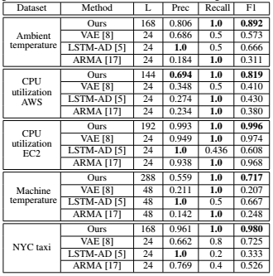
Results
Precision, recall and F1 score at the threshold that
gives the best F1 score (L: detection window length).

Slide 18
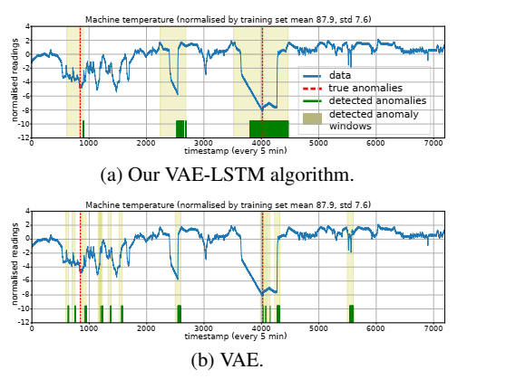
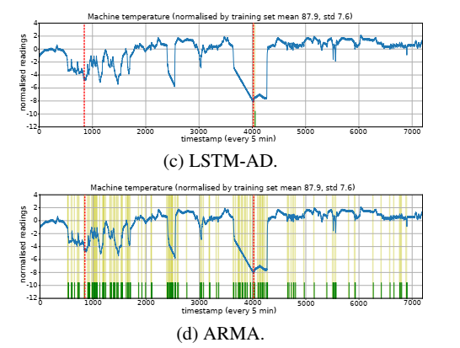
Anomalies detected using our VAE-LSTM, VAE, LSTM-AD and ARMA methods on the industrial machine temperature series

Slide 19
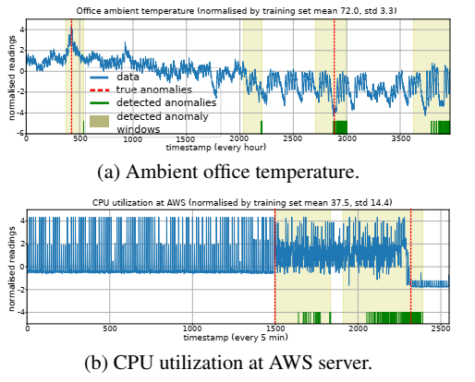
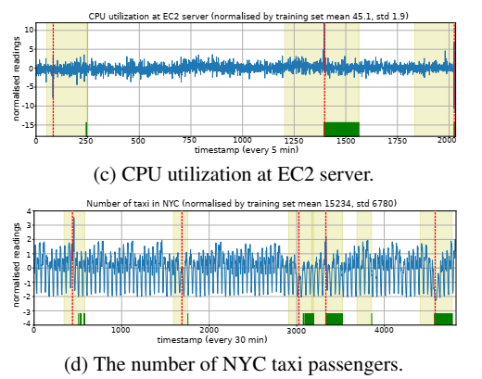
Anomalies detected by our VAE-LSTM hybrid model

Slide 20
Next work
Coding
Improve threshold parameter with KQE (Kernel Quantile Estimator)
Apply with Federated Learning model

